Slide 1
Introduction to E-Government
Flip Class on the EU Digital Identity Wallet and the Greek Digital ID
Kyriakos Lampros Kiouranas

Slide 2
EU Digital Identity Wallet
The EU Digital Identity Wallet is an innovative solution that aims to provide a secure and user-centric approach to digital identity.
It allows EU citizens to access a wide range of online services using a single digital identity.
The wallet is designed to be interoperable across member states, ensuring seamless authentication and access to public and private services.

Slide 3
Features of the EU Digital Identity Wallet
Secure Authentication: The wallet employs advanced encryption and authentication mechanisms to protect user data and ensure secure access to services.
Single Sign-On: Users can access multiple online services using their EU Digital Identity Wallet, eliminating the need for multiple usernames and passwords.
Cross-Border Mobility: Citizens can use their digital identity across EU member states, simplifying processes such as travel, e-commerce, and access to public services.

Slide 4
Benefits of the EU Digital Identity Wallet
Convenience: With a single digital identity, citizens can easily and quickly access a wide range of services, from healthcare to banking, with just a few clicks.
Privacy Protection: The wallet gives users control over their personal data, allowing them to choose what information is shared and with whom.
Increased Trust: By leveraging robust security measures, the EU Digital Identity Wallet enhances trust in online transactions and reduces the risk of identity fraud.

Slide 5
Greek Digital ID
Greece has implemented its own digital identity solution, known as the Greek Digital ID.
The Greek Digital ID offers Greek citizens a secure and efficient way to access public services, engage in e-commerce, and interact with the digital world.

Slide 6
Features of the Greek Digital ID
Seamless Integration: The Greek Digital ID seamlessly integrates with various public and private sector services, reducing administrative burden and simplifying processes.
Mobile-Friendly: The digital ID is accessible through mobile devices, ensuring convenience and ease of use for citizens on the go.
Strong Authentication: The Greek Digital ID employs multi-factor authentication methods, including biometrics, to enhance security and protect user identities.

Slide 7
Benefits of the Greek Digital ID
Streamlined Services: Citizens can access a wide range of public services, such as tax filing, healthcare appointments, and social security benefits, conveniently and efficiently.
Digital Transformation: The Greek Digital ID plays a vital role in Greece's digital transformation efforts, promoting e-governance and fostering innovation in the public sector.
Empowered Citizens: By enabling citizens to access and manage their digital identities easily, the Greek Digital ID empowers individuals to participate fully in the digital society.

Slide 8
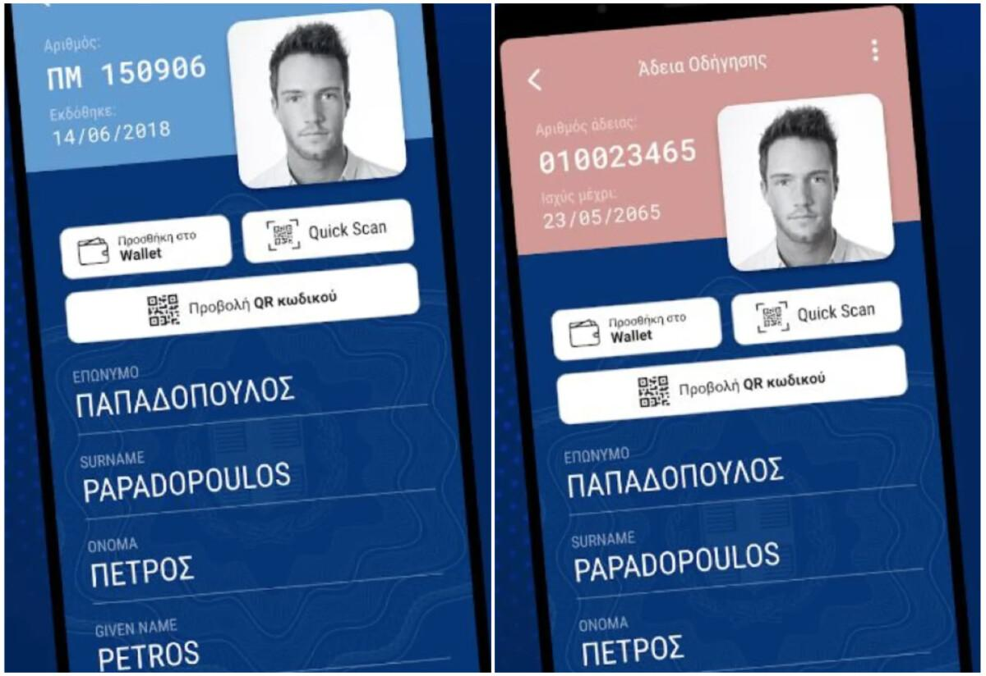
The Greek Digital ID and Driver License

Slide 9
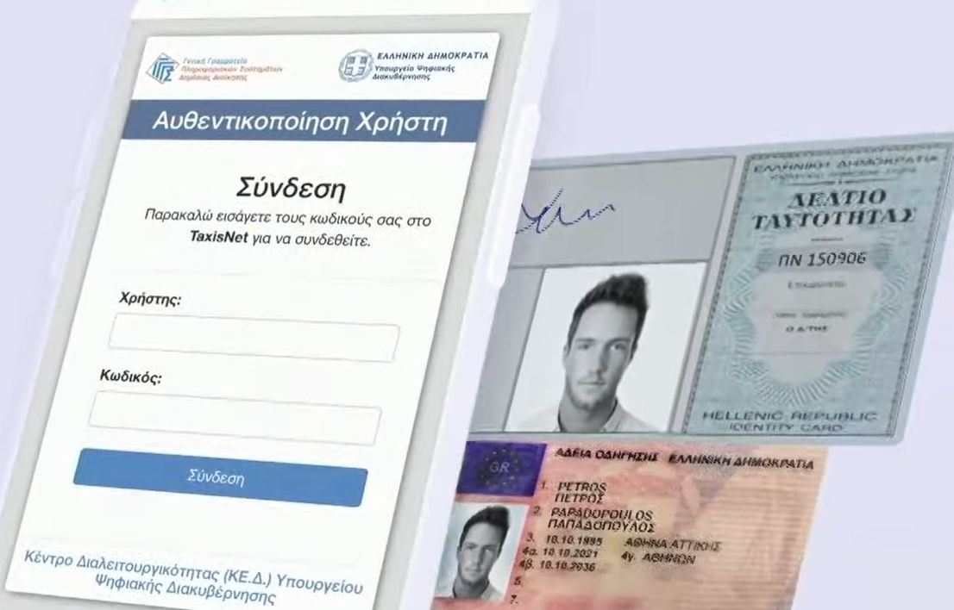
The Signing process to the Greek Digital ID and Driver License

Slide 10
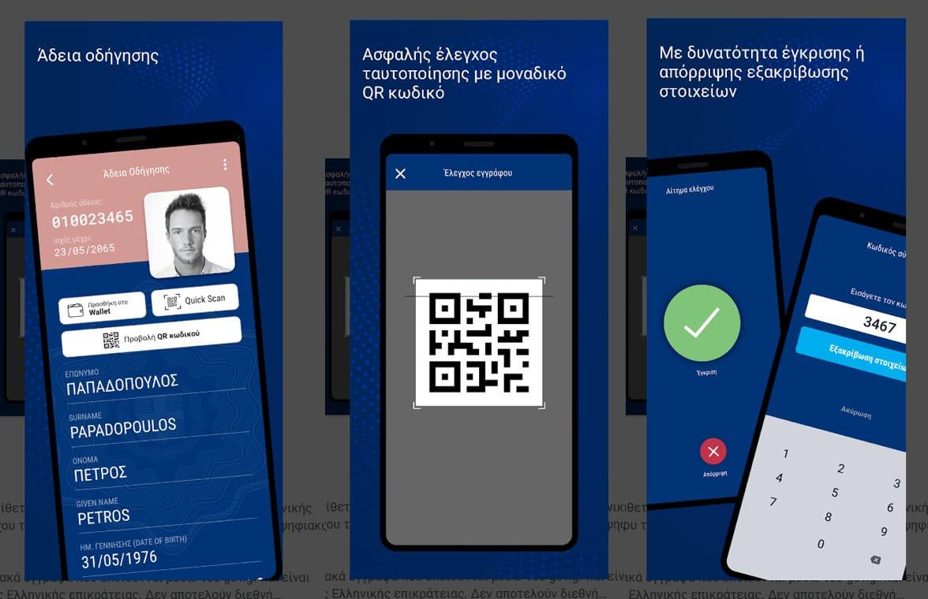
The check of the authenticity of the Greek Digital ID and Driver License

Slide 11
Conclusion
In conclusion, the EU Digital Identity Wallet and the Greek Digital ID are revolutionizing the way citizens engage with digital services.
These initiatives provide secure, user-centric, and interoperable digital identity solutions, enhancing convenience, privacy, and trust.
By embracing these technologies, we can create a future where citizens have greater control over their digital lives while enjoying seamless access to essential services.

Slide 12
References
https://www.nfcw.com/2022/07/29/378338/greece-rolls-out-digital-id-cards-and-driving-licences/
https://neoskosmos.com/en/2022/08/28/news/thousands-of-greeks-already-use-new-digital-id/ https://news.gtp.gr/2022/07/28/greek-citizens-can-store-national-id-drivers-license-new-wallet-app/ https://www.ekathimerini.com/news/1186666/minister-unveils-new-digital-tools-including-e-id/ https://www.biometricupdate.com/202201/greece-to-introduce-full-mobile-version-of-digital-id-driving-licenses
https://dukakis.org/shaping-futures/greece-rolls-out-digital-id-cards-and-driving-licences/ https://www.electronicid.eu/en/blog/post/european-digital-identity-wallet/en https://cointelegraph.com/news/europe-s-digital-id-wallet-easy-for-users-or-a-data-privacy-nightmare https://www.thalesgroup.com/en/markets/digital-identity-and-security/government/identity/eidas-regulations https://digital-strategy.ec.europa.eu/en/policies/eudi-wallet-implementation
https://commission.europa.eu/strategy-and-policy/priorities-2019-2024/europe-fit-digital-age/european-digital-identity_en/

Slide 13
Thank you for your attention

